Slide 1
LANDLORD
A mobile game made by Group 01

Slide 2


MEMBERS
Nguyen Van Giap
Hoang Ha

Slide 3


MEMBERS
Ha Anh Tuan
Truong Quoc Tuan

Slide 4
GAME CONCEPTS
The first version of landlord

Slide 5
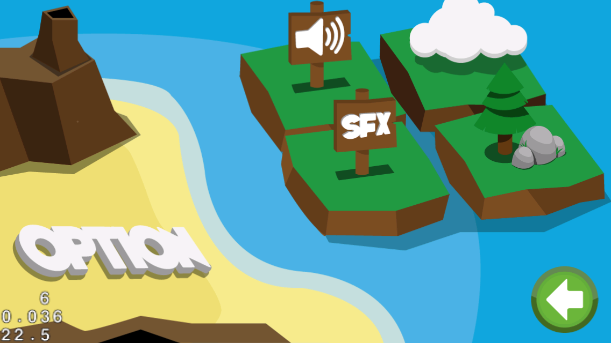
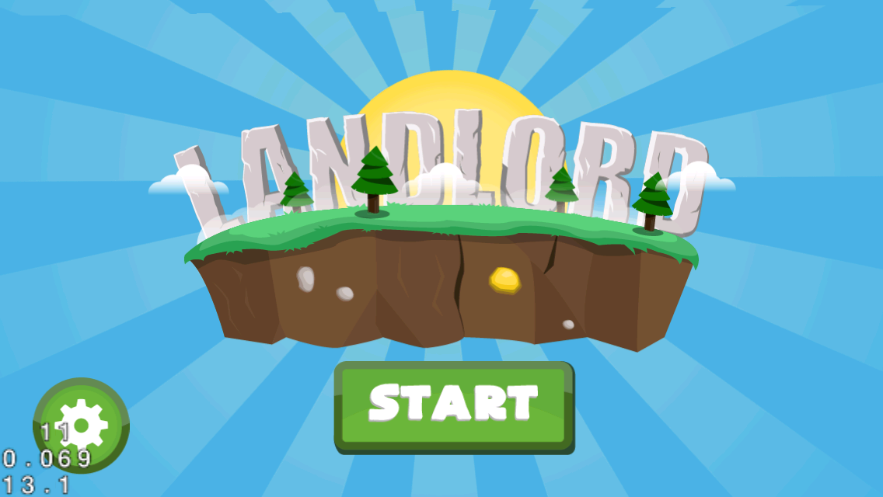

Slide 6
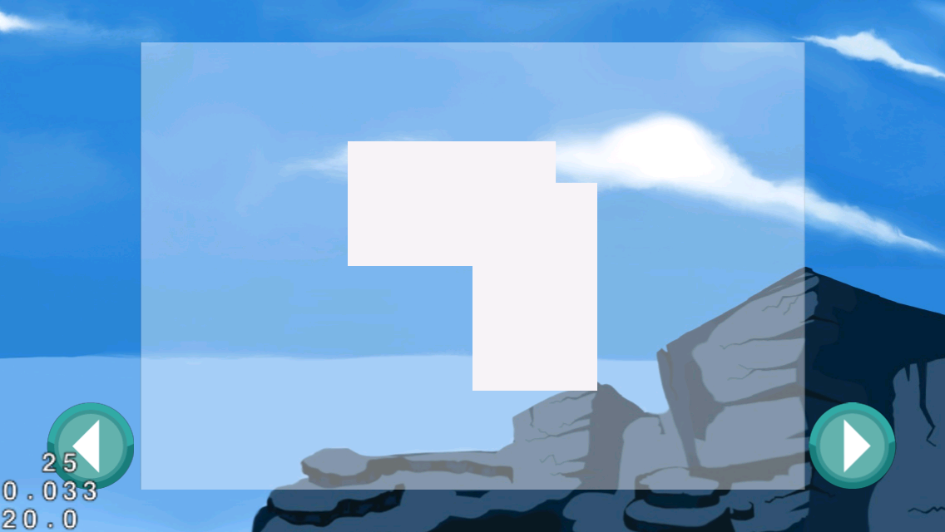
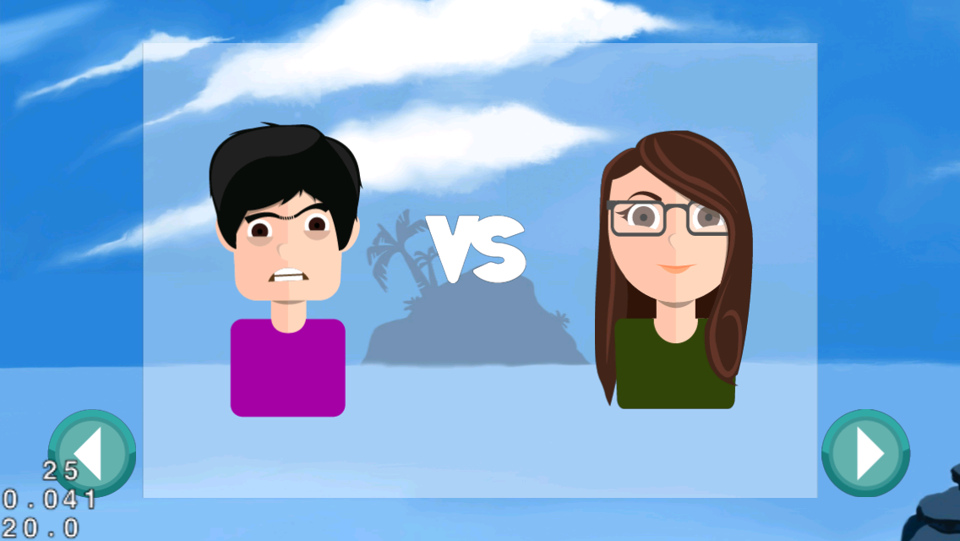

Slide 7
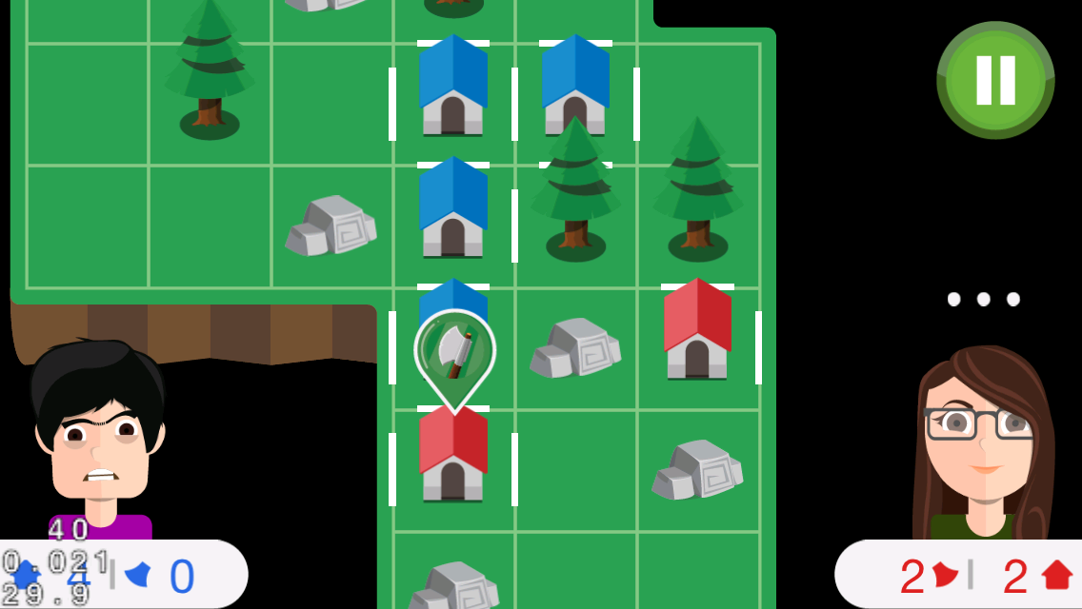
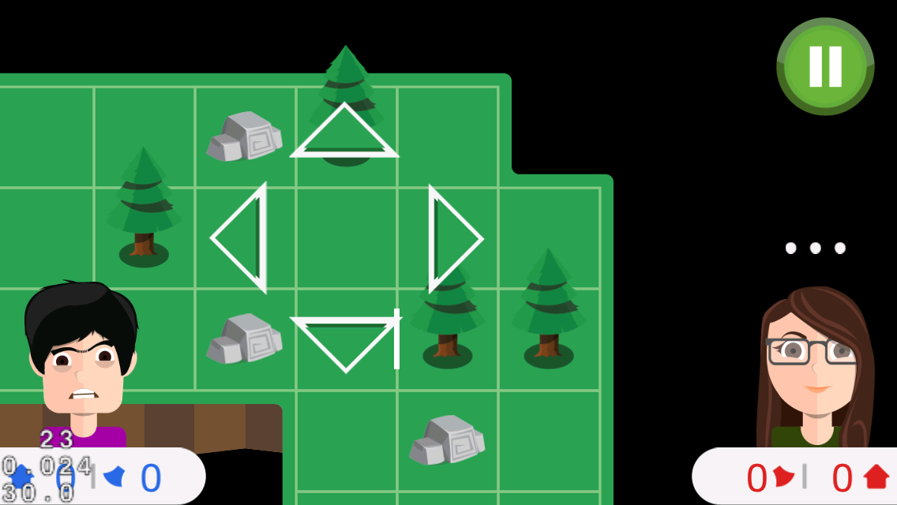

Slide 8
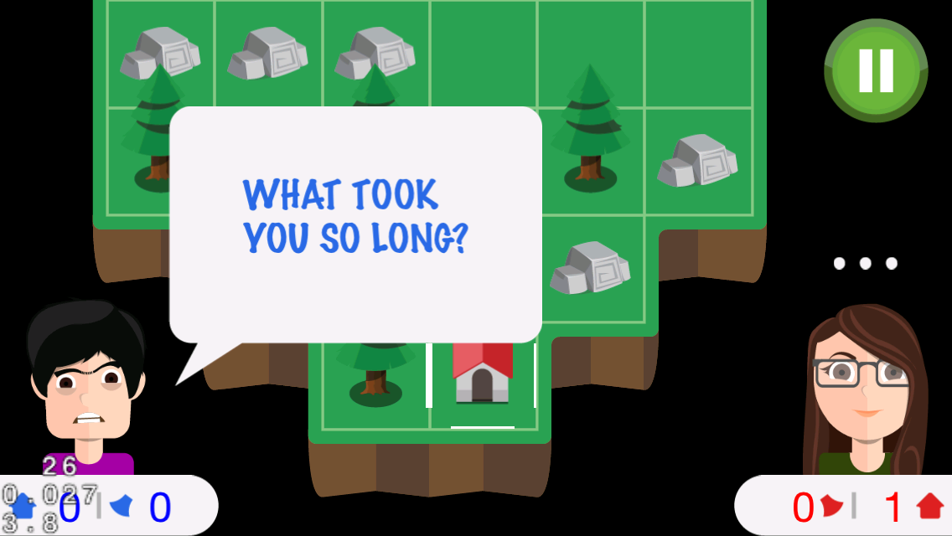
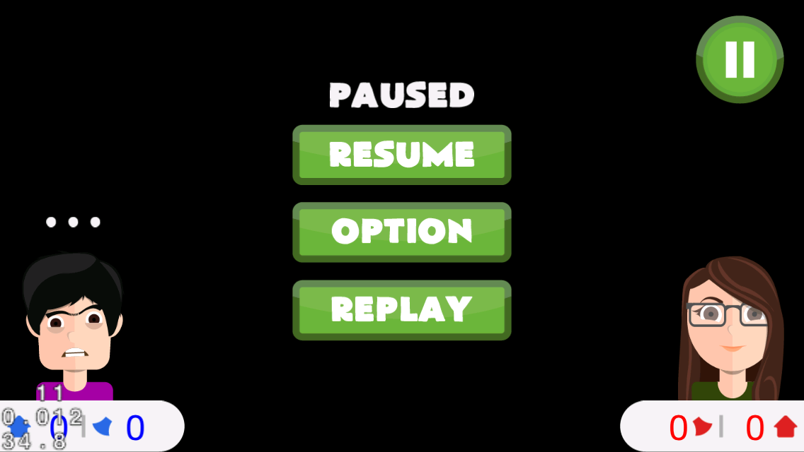

Slide 9
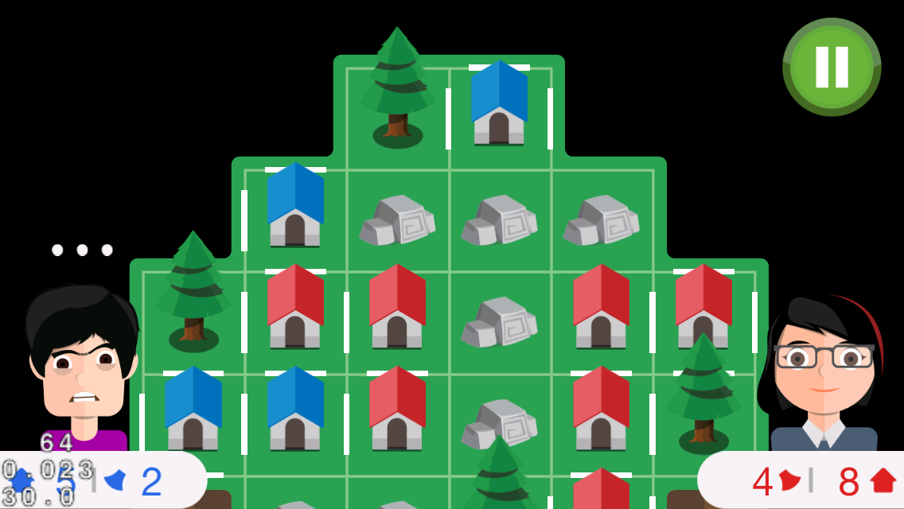


Slide 10
IDEA
inspired by a game on paper
a board game
2-player
FUN and COOL

Slide 11
GAMEPLAY
two players compete with each other
build houses and occupy the islands
tree mode, axes, …
https://github.com/tranvictor/landlord/ wiki

Slide 12
CONTROL
touch on tiles!
choose the edge to put fence
special tiles with hidden axe, tree, stone !
collect axes
use axe to cut trees

Slide 13

COCOS2D-X
An awesome framework for making cross platform mobile games

Slide 14
PROJECT MANAGEMENT
pivotaltracker.com/s/projects/1031608

Slide 15
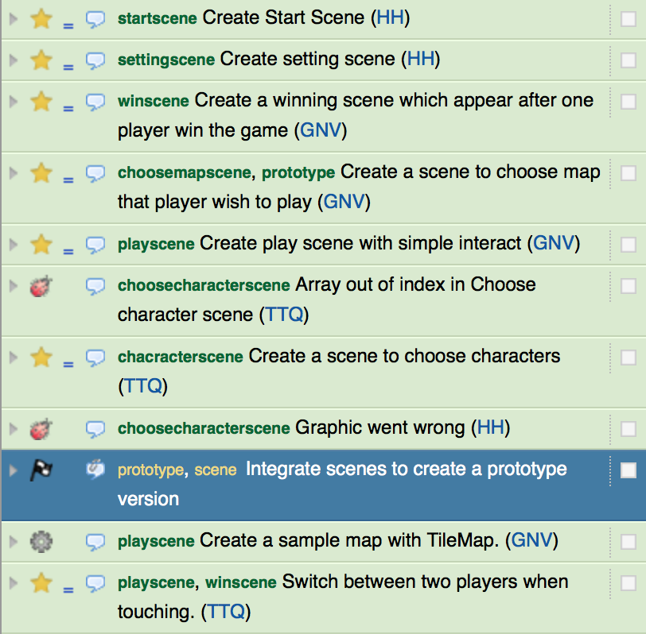
PIVOTALTRACKER

Slide 16
REVISION CONTROL AND SOURCE CODE MANAGEMENT
github.com/tranvictor/landlord

Slide 17
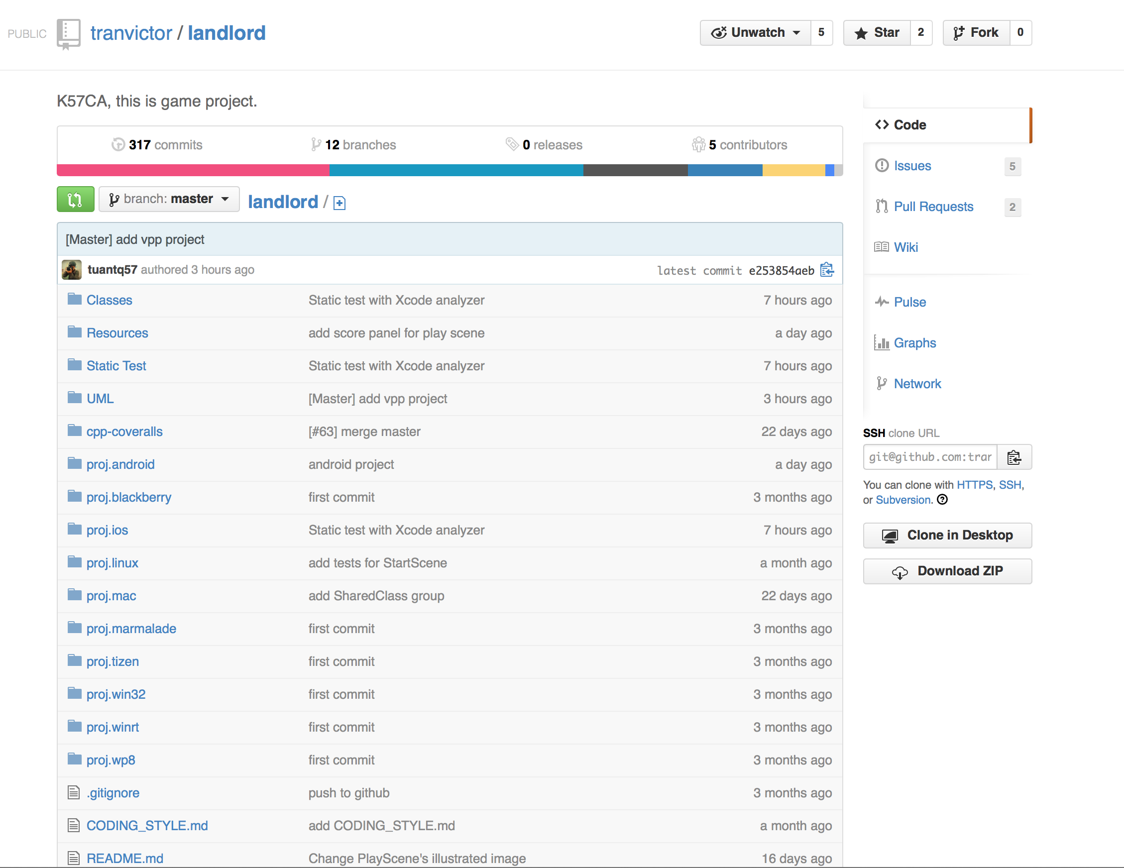
GITHUB REPO

Slide 18
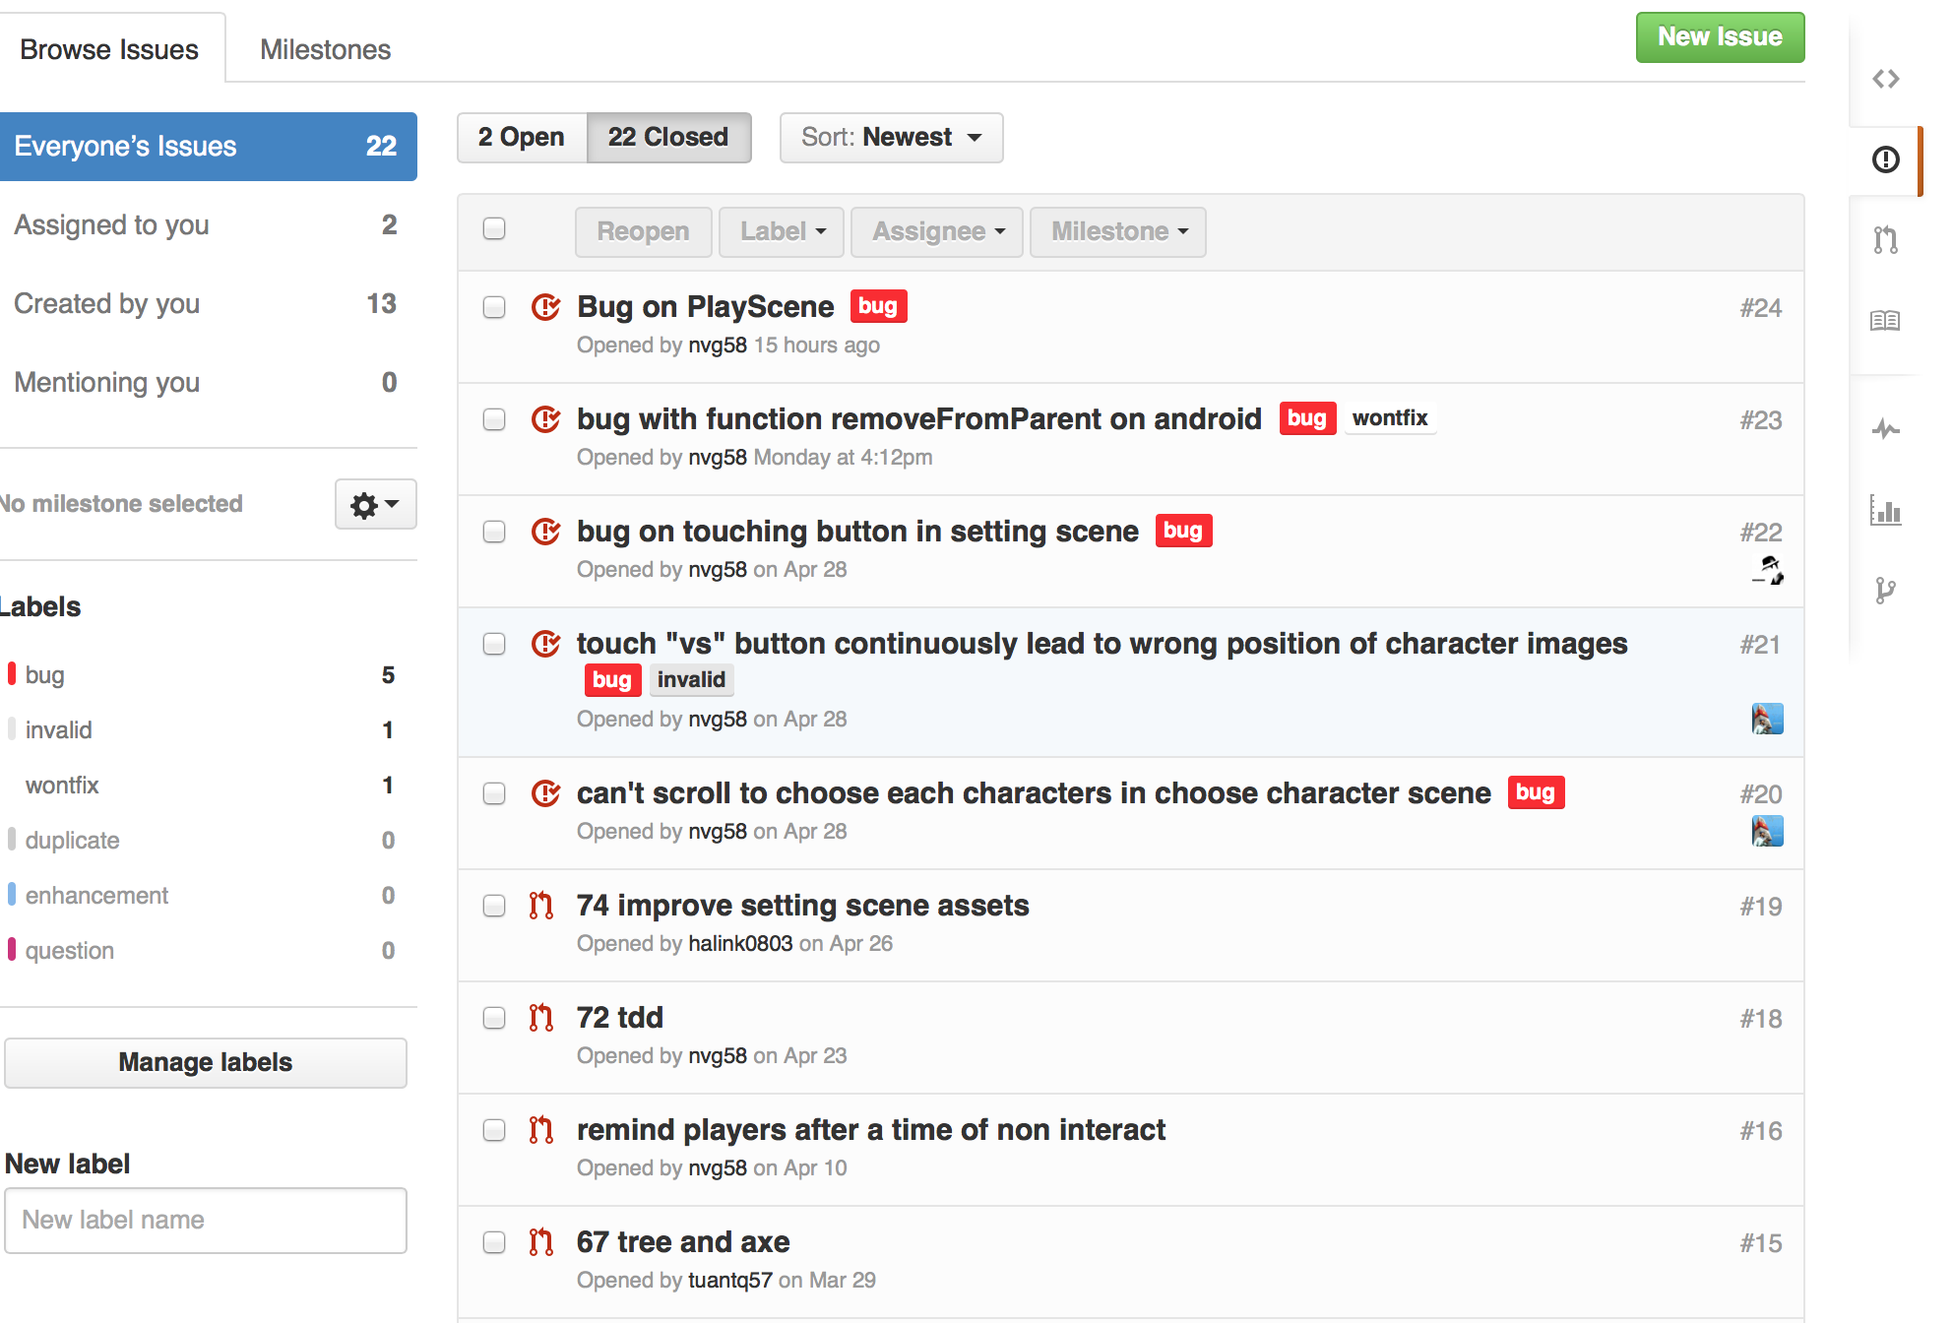
BUG TRACKING

Slide 19
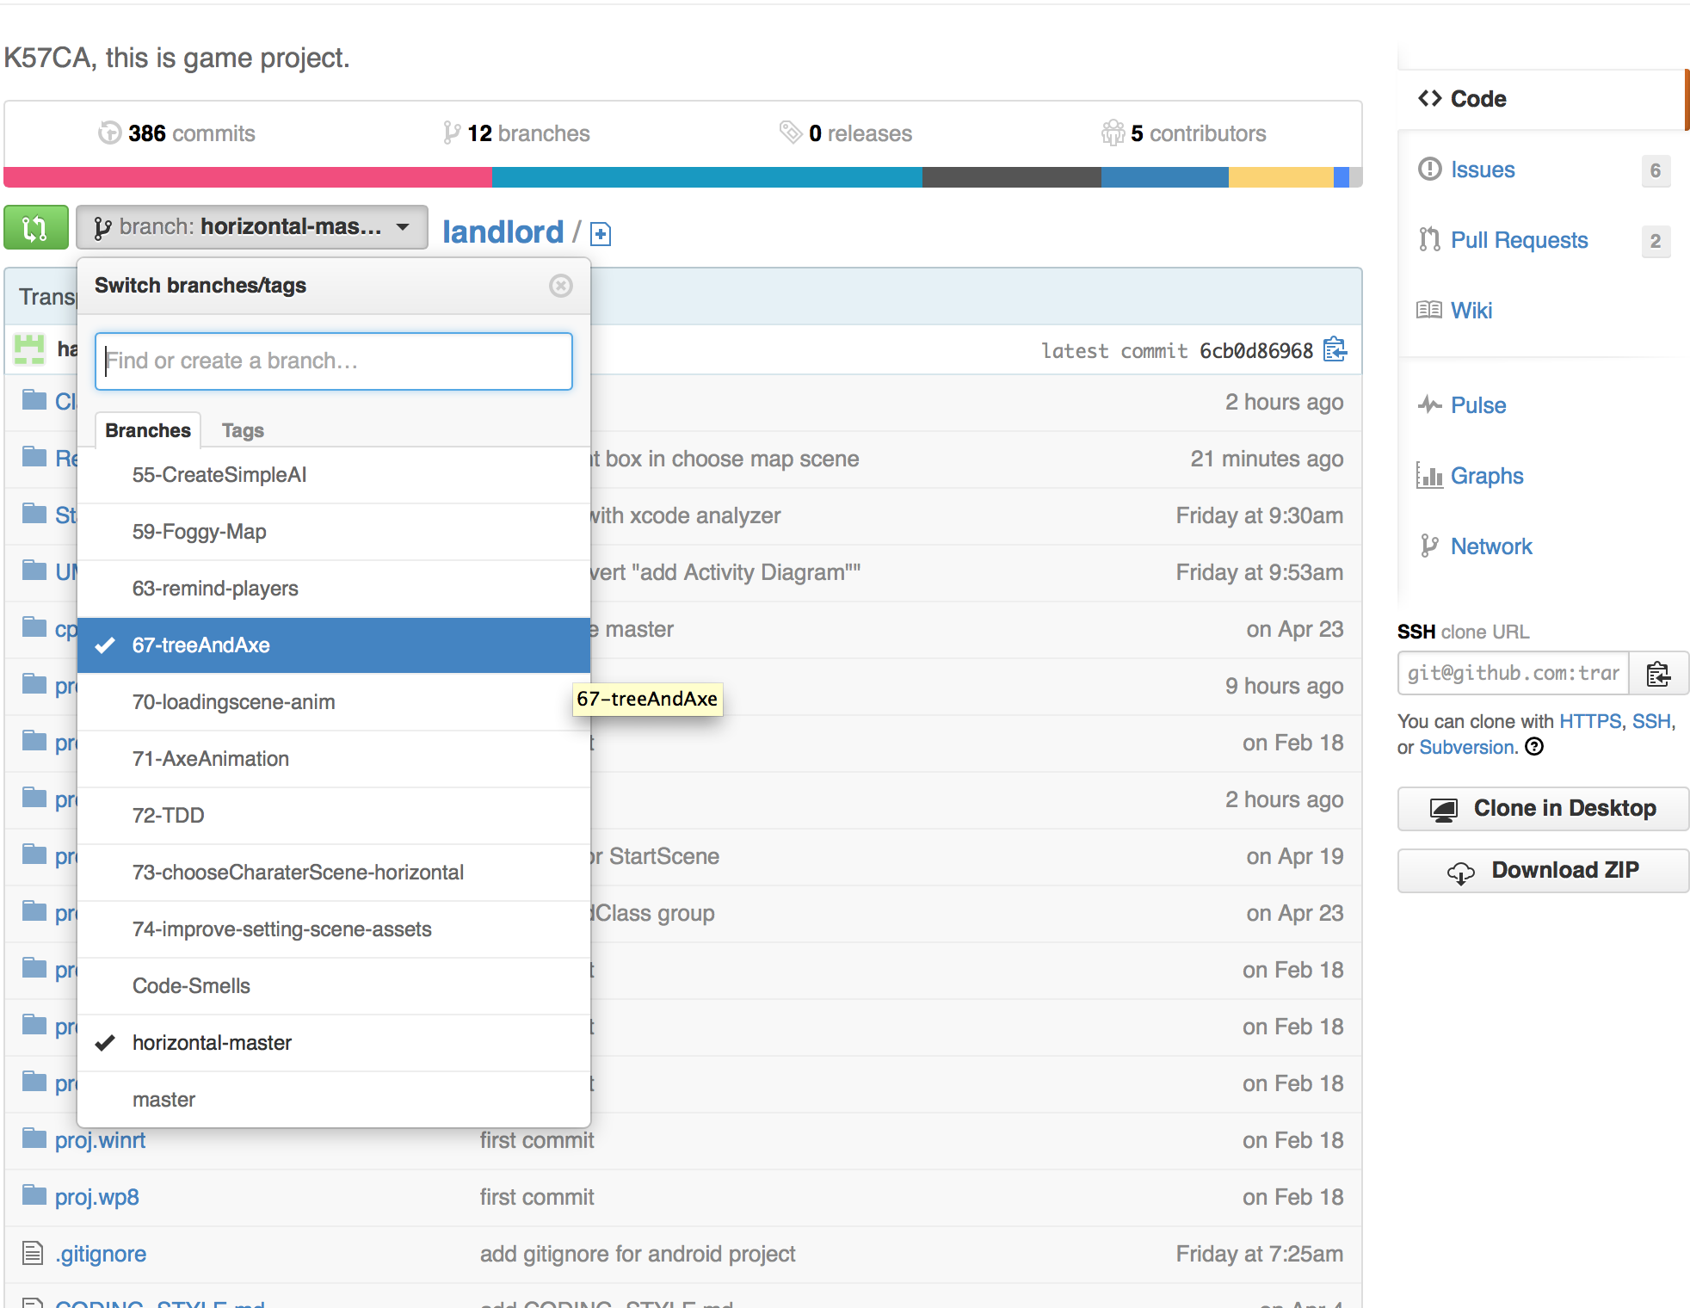
GIT WORKFLOW

Slide 20
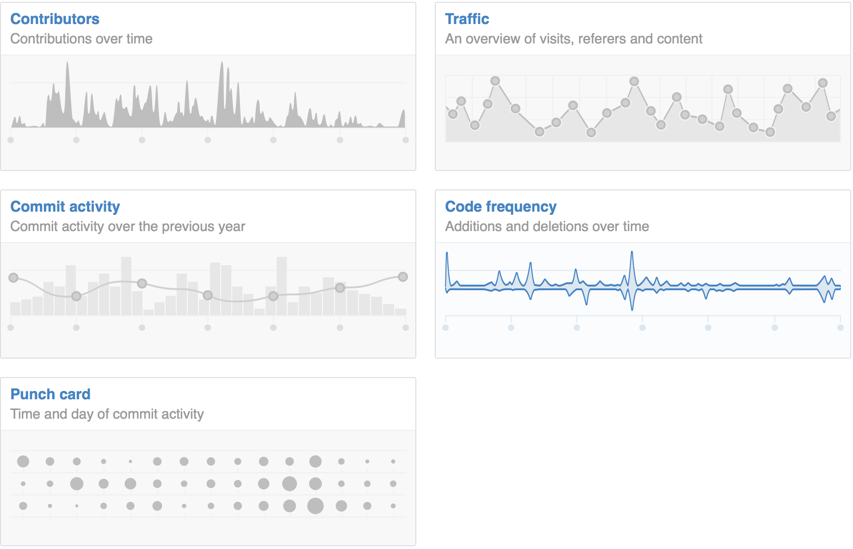
STATISTICS

Slide 21
SOFTWARE DEVELOPMENT PROCESS
Using Test-driven development (TDD)

Slide 22
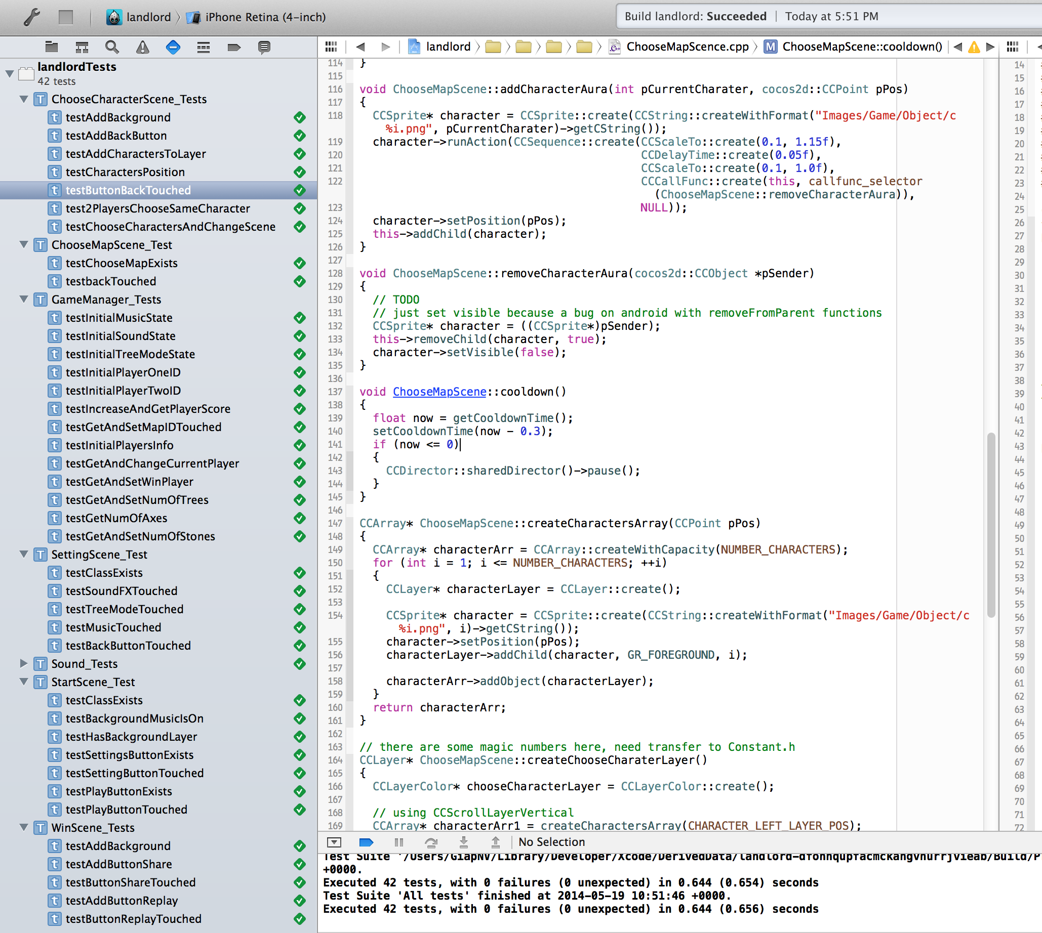
SENTESTINGKIT

Slide 23
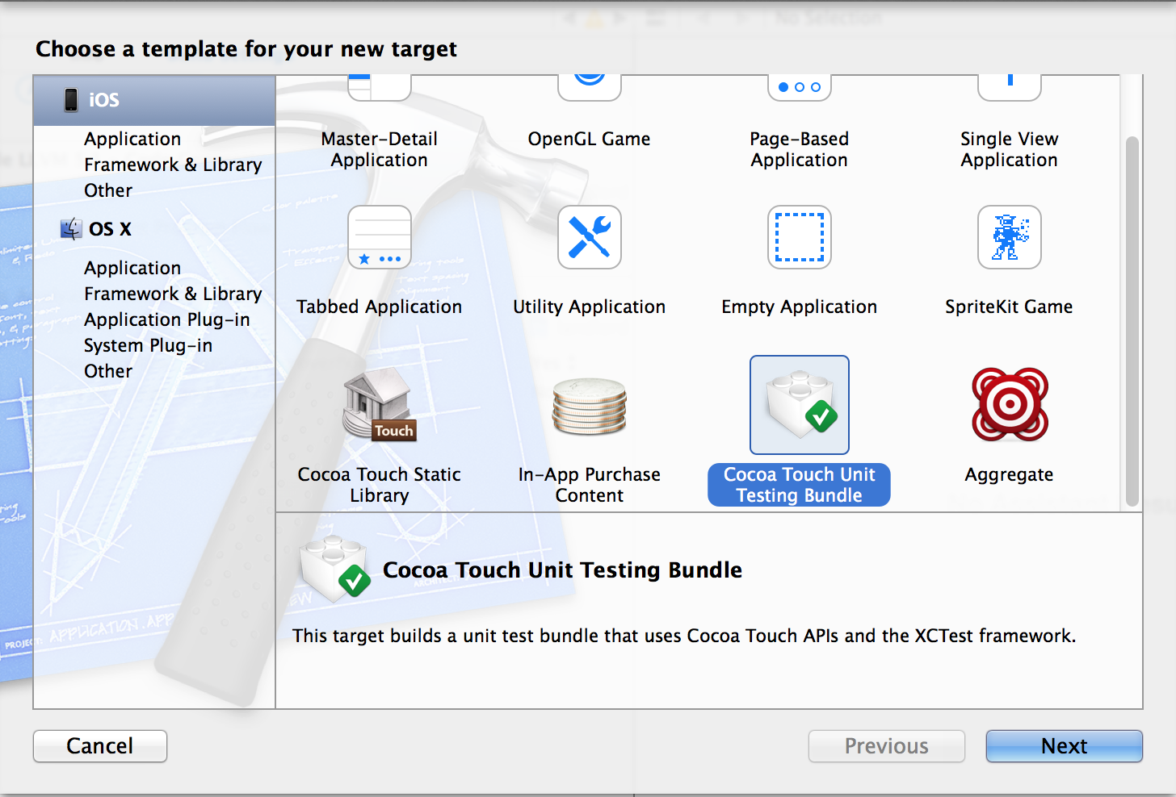
COCOA TOUCH UNIT TESTING

Slide 24
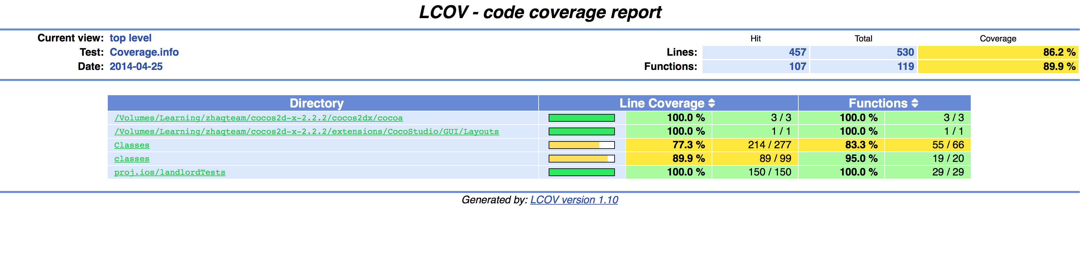
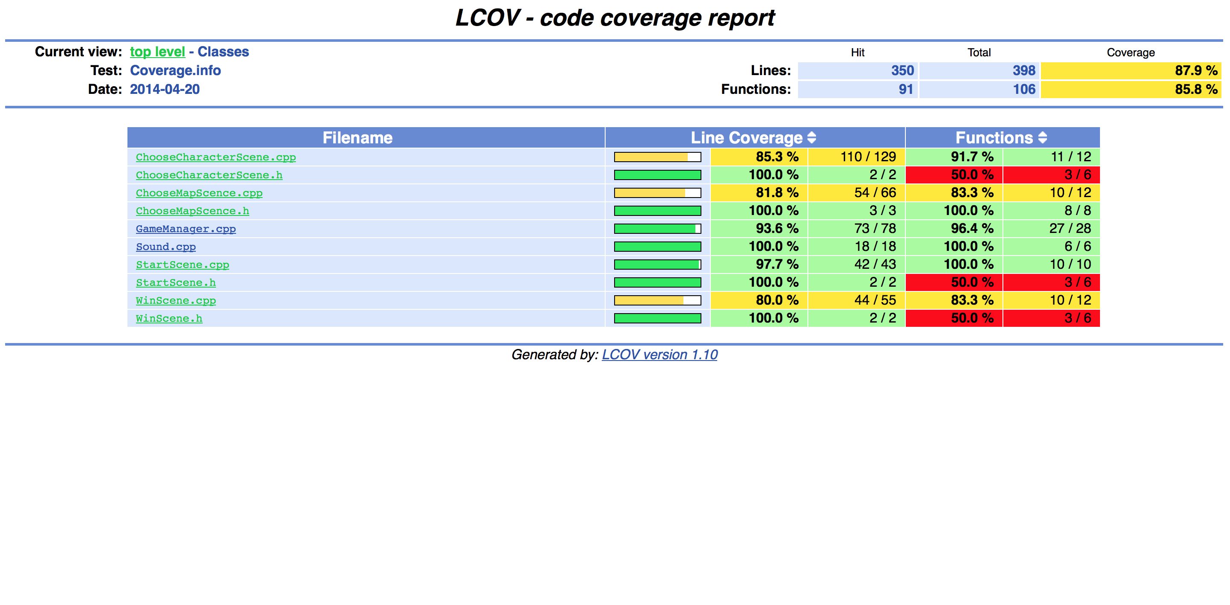
TEST COVERAGE

Slide 25
STATIC SOURCE CODE ANALYSIS
Using LLVM 3.4

Slide 26
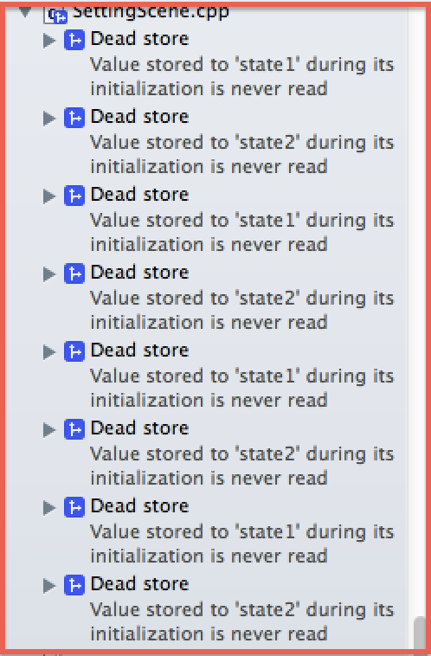
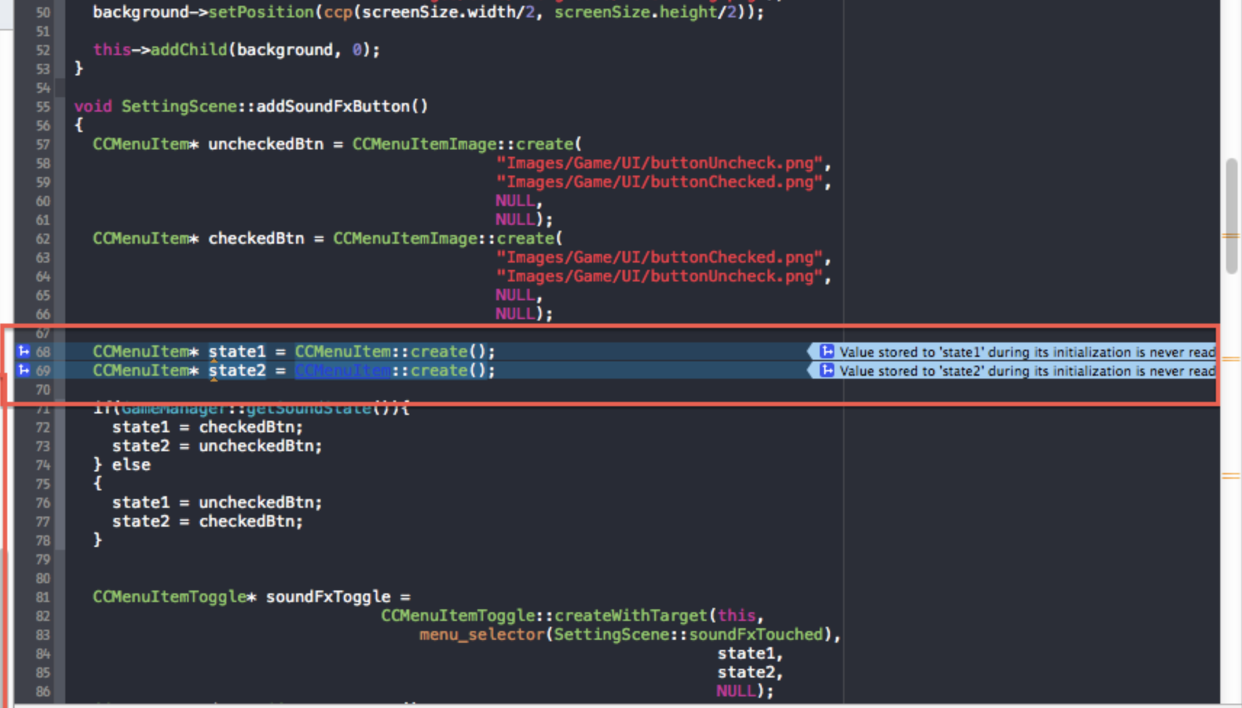
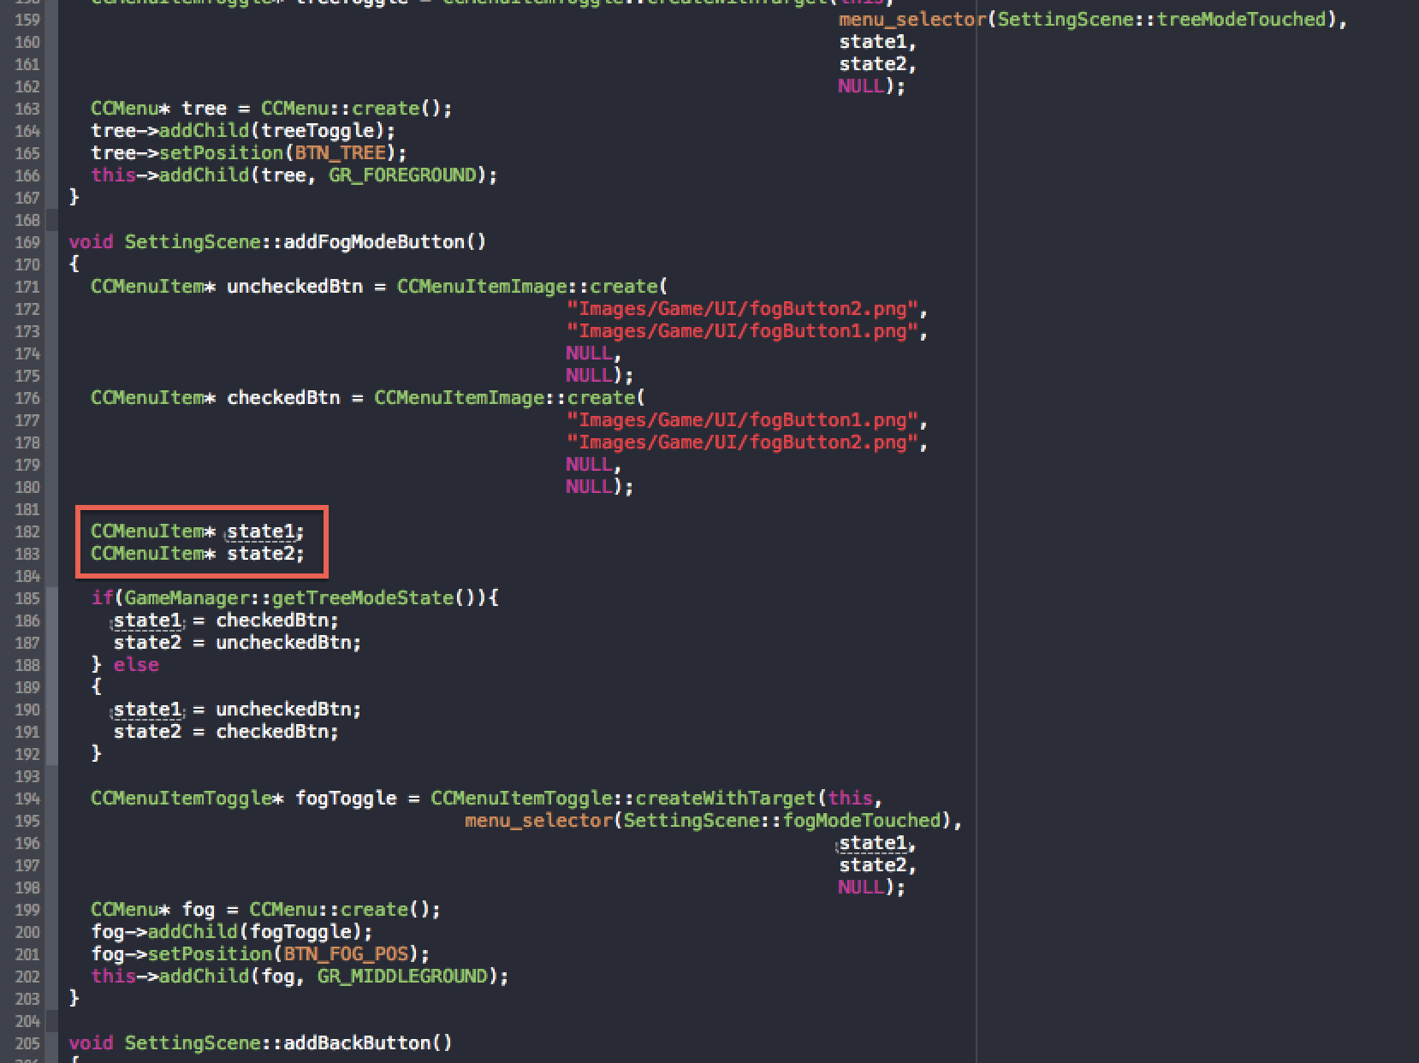
LLVM 3.4

Slide 27
SYSTEM'S ARCHITECTURAL BLUEPRINTS
Unified Modeling Language (UML)

Slide 28
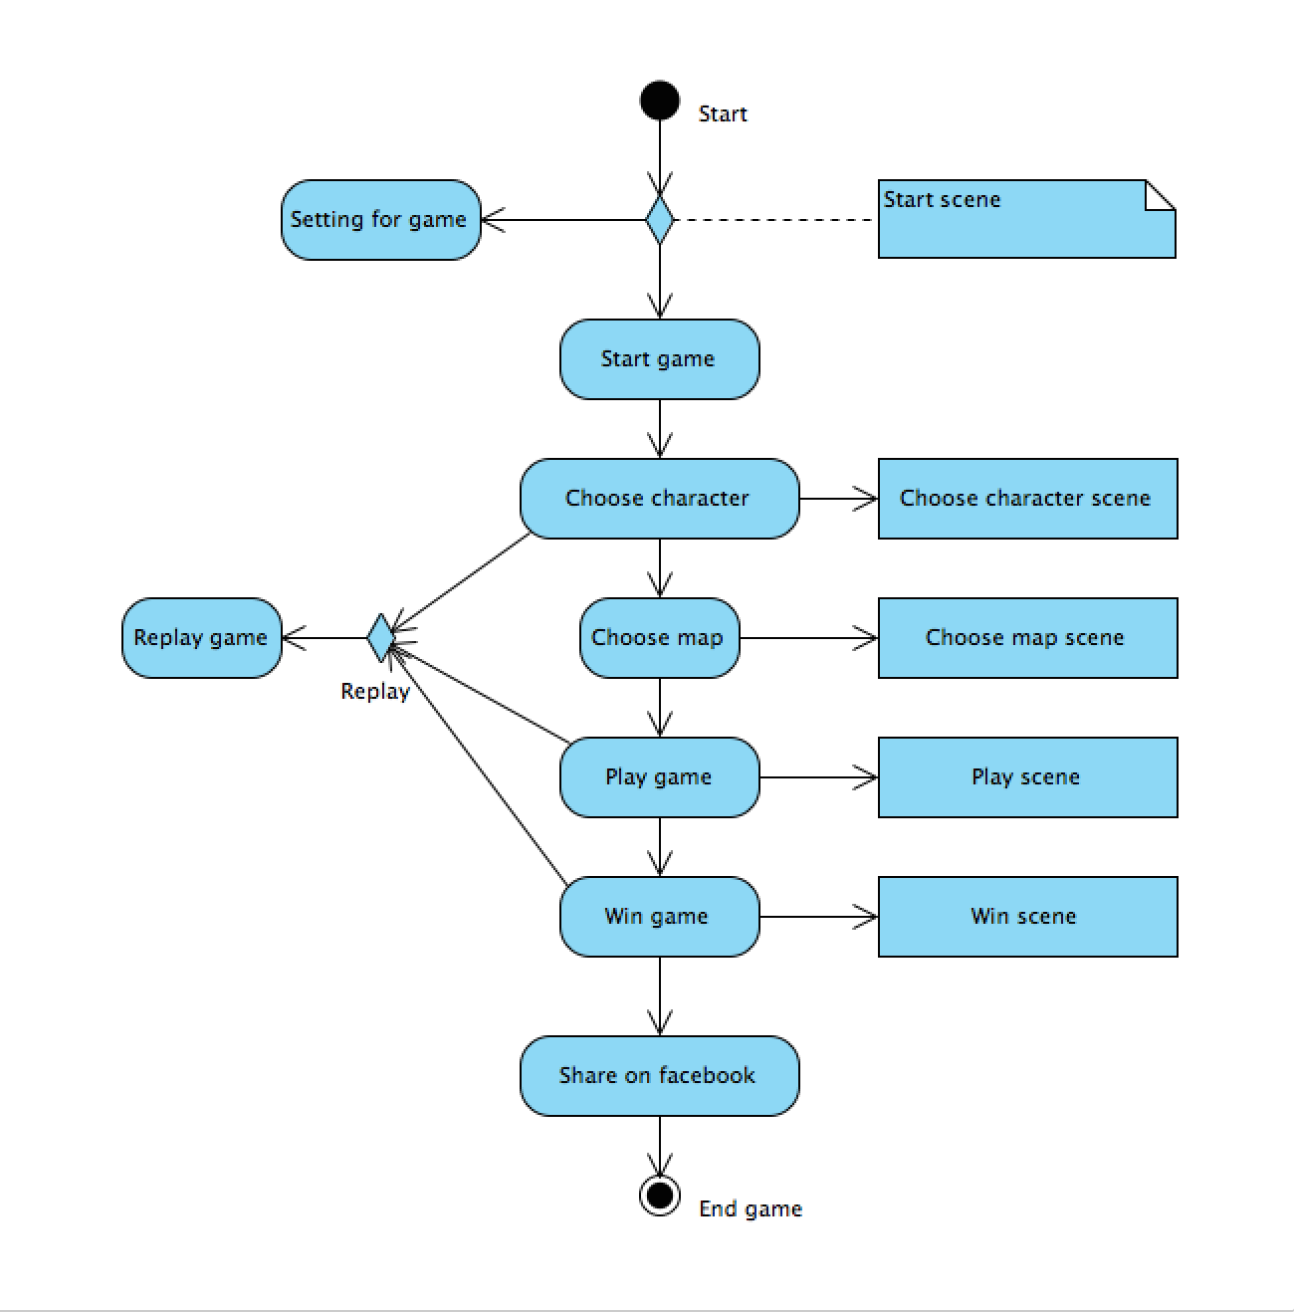
ACTIVITY DIAGRAM

Slide 29
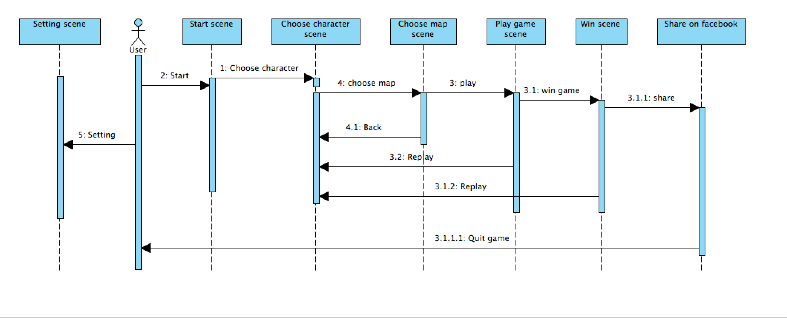
SEQUENCE DIAGRAM

Slide 30
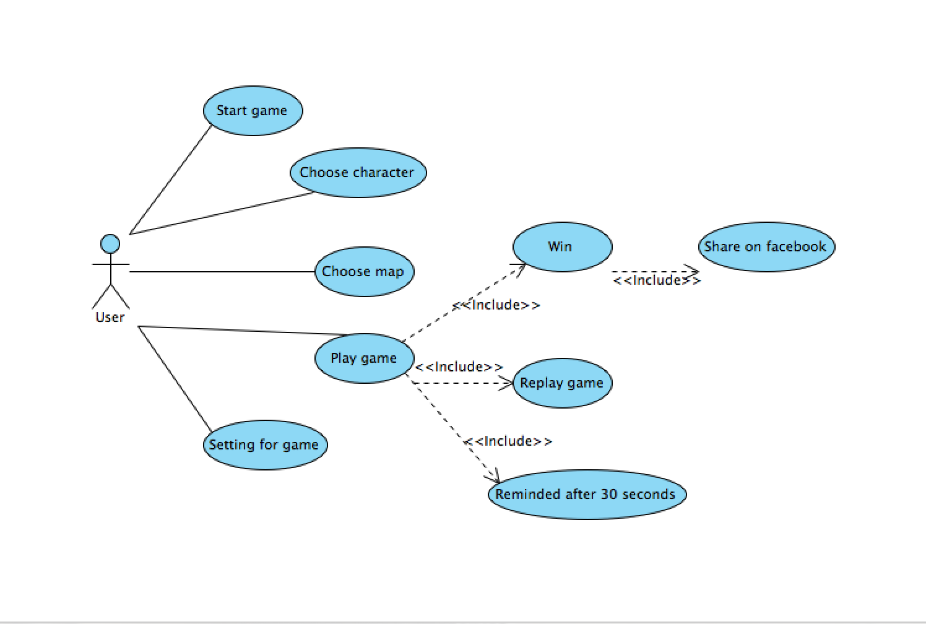
USER CASE DIAGRAM

Slide 31
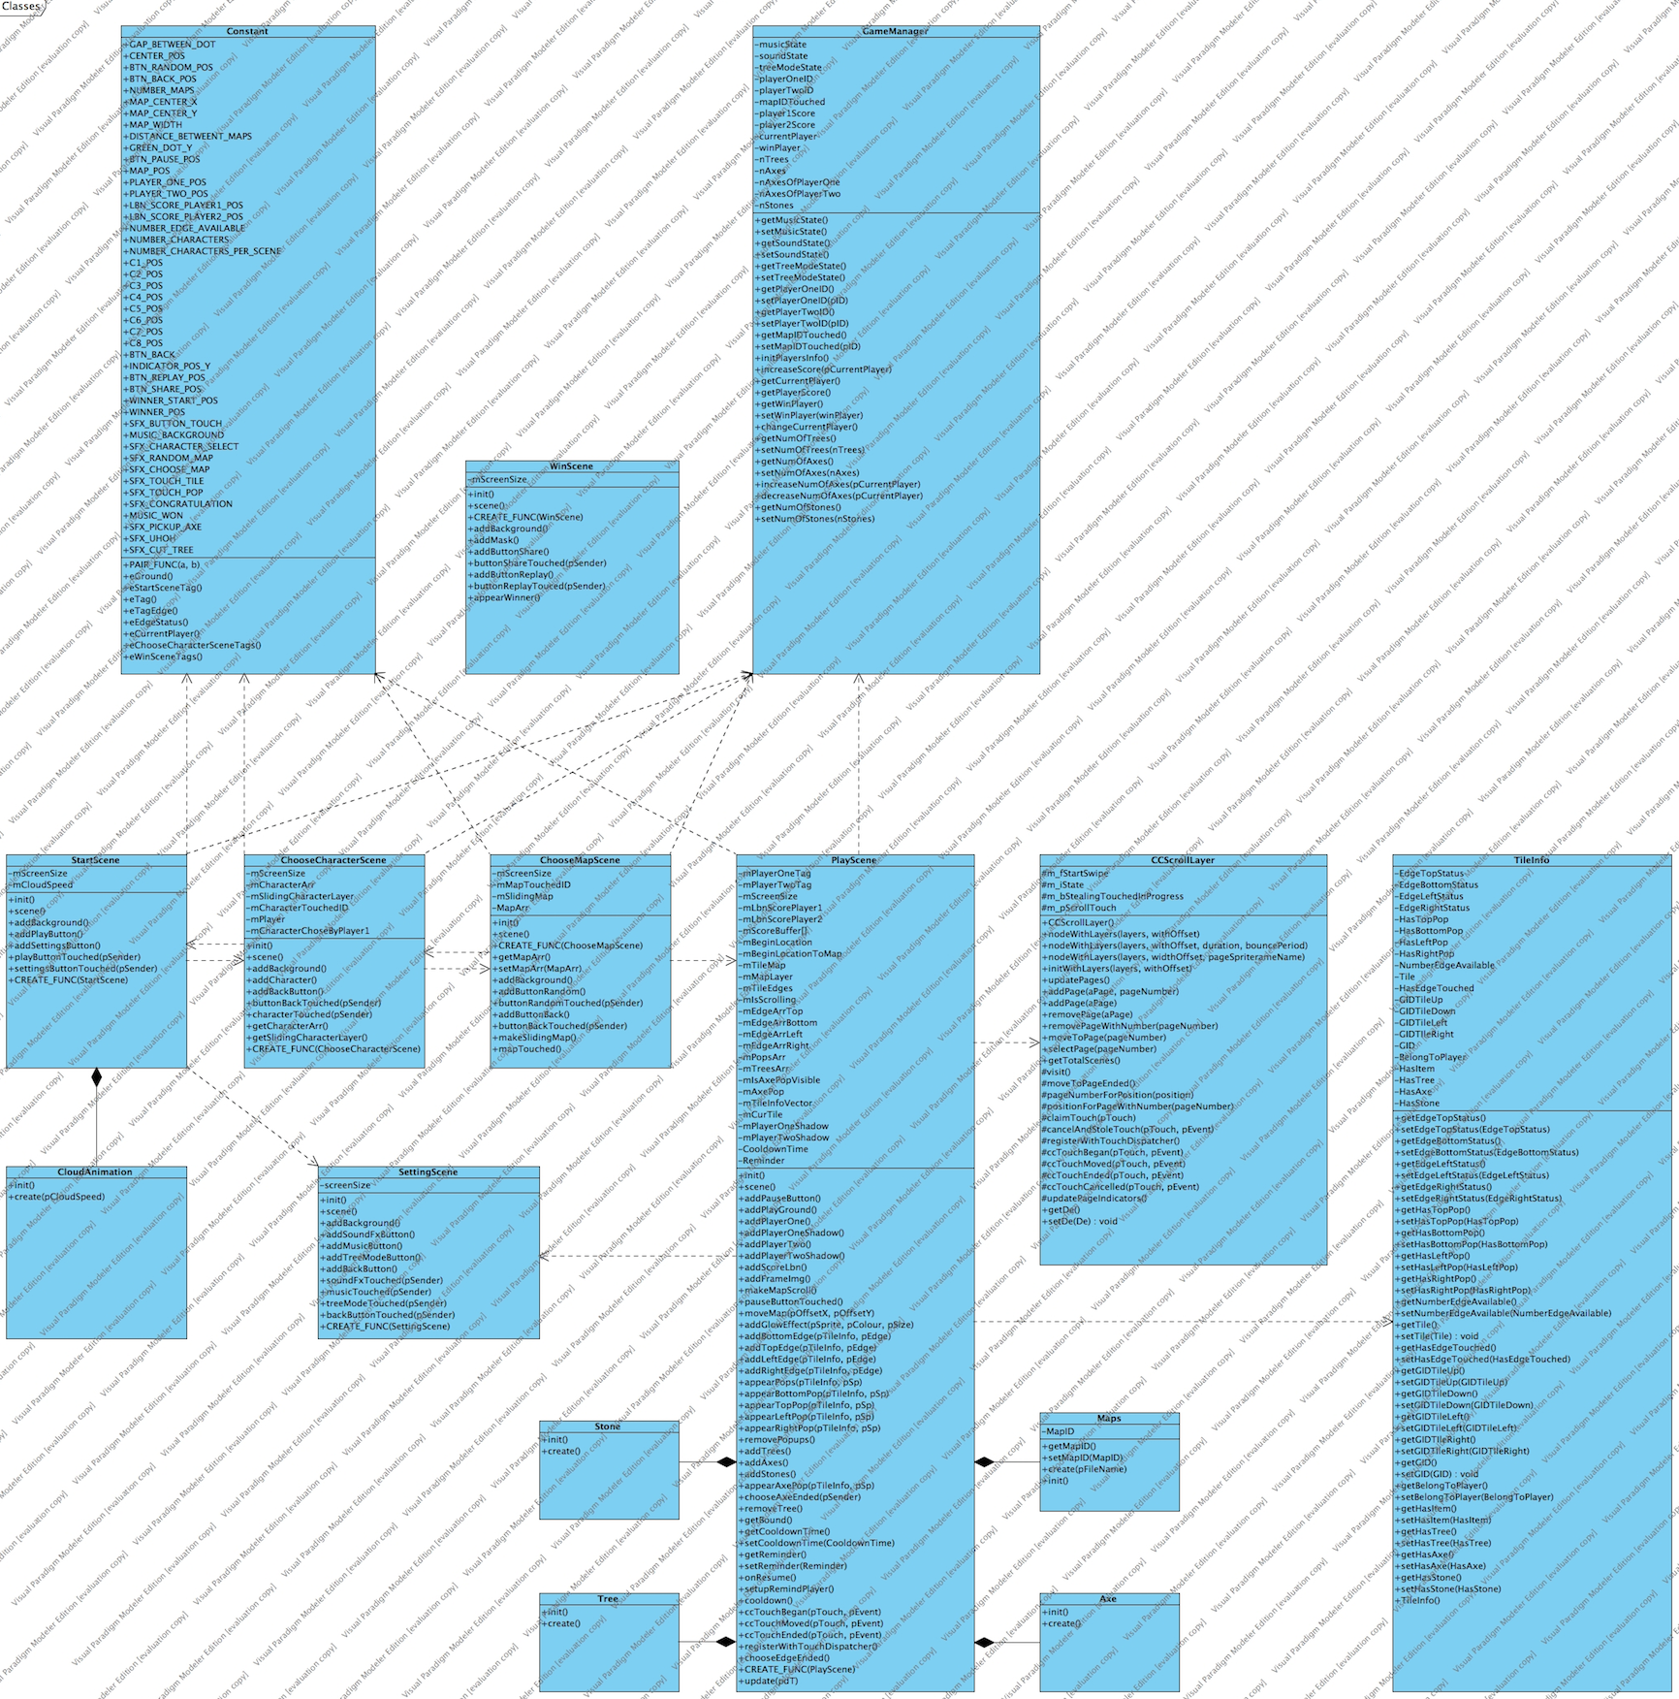
CLASS DIAGRAM

Slide 32
RELEASE
V0.1

Slide 33
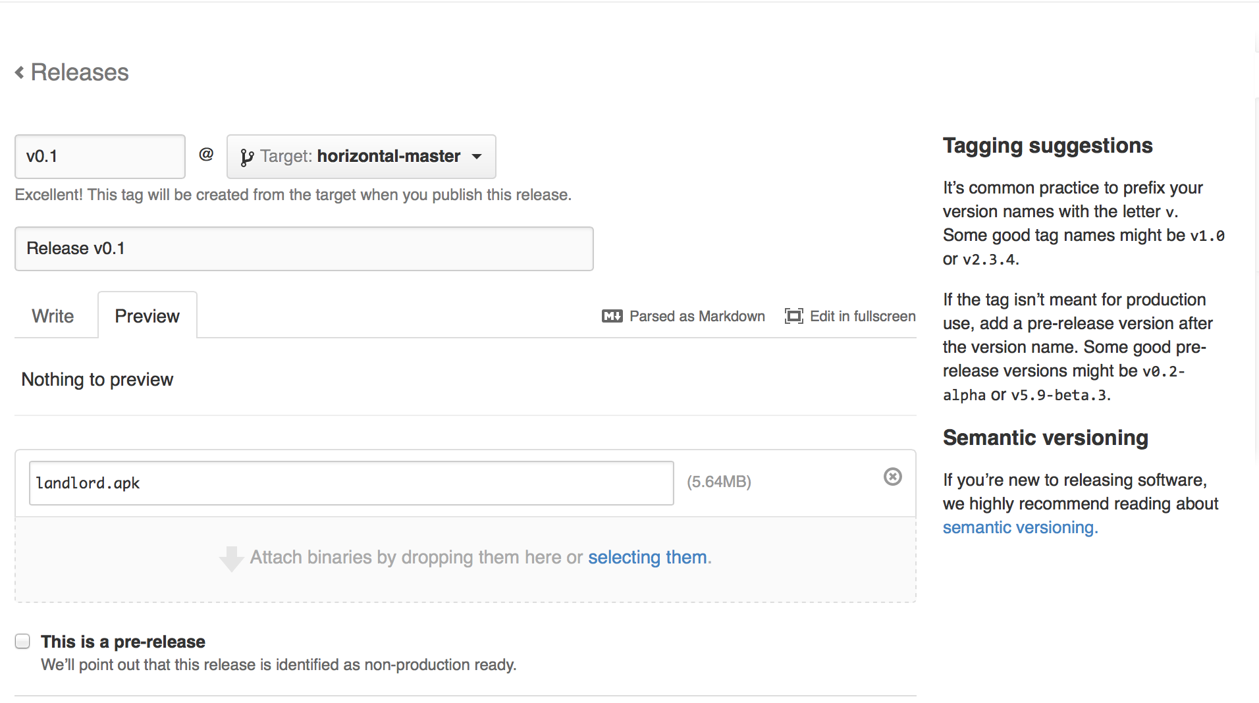
v0.1

Slide 34
THANK YOU FOR YOUR LISTENING!

